Slide 1
Dates and Times with Lubridate
Daniel Brito and Shruthi Naik

Slide 2
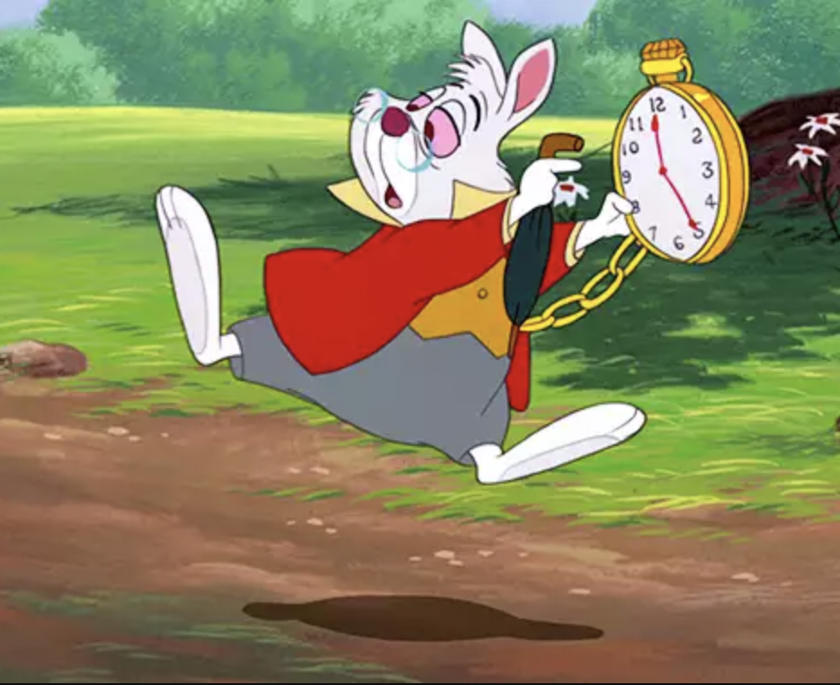
Why do we need a package for dates and times?
Dates come in different forms and shapes:
01.09.2022
01/09/22
09-01-2022
SEP-09-22
September, 09, 2022
09 SEP 22

Slide 3
Why do we need a package for dates and times?
Dates and times have many details…
How many days does a year have?
What about leap years?
How many hours does a day have?
What about daylight savings time (DST)
Different time zones
GMT, UTC, CET…
What time is it in Brazil?
What's the date in Japan?
Lubridate helps us do calculations with dates and times!

Slide 4
Date and time objects
Date objects
Date and time objects
Class: "Date"
> today <- today()
> today
[1] "2022-11-14"
> class(today)
[1] "Date"
R uses the format YYYY-MM-DD
Class: "POSIXct"
> now <- now()
> now
[1] "2022-11-14 09:47:54 CET"
> class(now)
[1] "POSIXct" "POSIXt"

Slide 5
Creating date and date-time objects
What class do these belong to?
[1] date_1 <- "1998 06 20”
[2] date_2 <- c(1998-06-20, 1998-07-21)
[3] datetime_2 <- "1998 06 20 14:23:00"
How can we tell R these are dates or datetimes?
as_date
as_datetime
[1] "character"
[2] "numeric"
[3] "character"

Slide 6
Creating date and date-time objects
But they only work with the format YYYY-MM-DD!
> as_date("21 November 2022")
[1] NA
> as_datetime("21 November 2022")
[1] NA
> as_date("21112022")
[1] NA
> as_datetime("21112022")
[1] NA
> as_date("2022 November 21")
[1] "2022-11-21"
> as_datetime("2022 November 21")
[1] "2022-11-21 UTC"
> as_date("20221121")
[1] "2022-11-21"
> as_datetime("20221121")
[1] "2022-11-21 UTC"

Slide 7
Creating date and date-time objects
Date | Date and time
> dmy("21st November 2022")
[1] "2022-11-21"
> mdy("11-21-2022")
[1] "2022-11-21"
> ymd(20221121)
[1] "2022-11-21"
> ymd_hms("2022-11-21 12:20:59")
[1] "2022-11-21 12:20:59 UTC"
> mdy_hm("11/21/2022 12:20")
[1] "2022-11-21 12:20:00 UTC"
> dmy(21112022, tz = "UTC")
[1] "2022-11-21 UTC"
How can we tell R whether 02-01-2001 is 2nd January 2001 or 1st February 2001?
Helper functions!

Slide 8
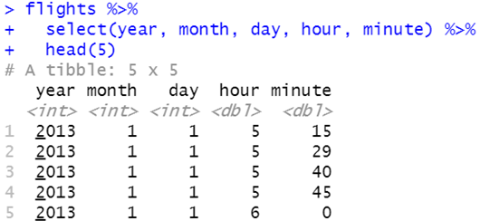
Creating date/time by merging data
How do we merge the columns to one date and time column?
make_datetime

Slide 9
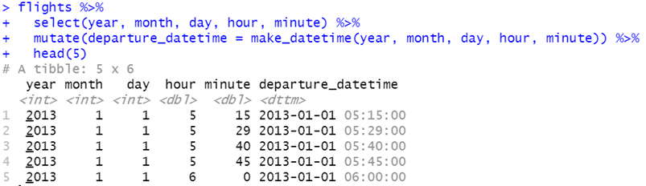
Creating date/time by merging data

Slide 10
Extract components
How can we extract a component from this datetime column? E.g. the month?
> test <- flights_dt$dep_time %>% sample(5)
> test
[1] "2013-07-18 12:03:00 UTC"
[2] "2013-10-26 07:22:00 UTC"
[3] "2013-10-02 19:24:00 UTC"
[4] "2013-10-13 14:01:00 UTC"
[5] "2013-12-08 09:47:00 UTC"
> year(test)
[1] 2013 2013 2013 2013 2013
> month(test)
[1] 7 10 10 10 12
> day(test)
[1] 18 26 2 13 8
> hour(test)
[1] 12 7 19 14 9
> minute(test)
[1] 3 22 24 1 47
> second(test)
[1] 0 0 0 0 0
> tz(test)
[1] "UTC"

Slide 11
Extract components
example <- ymd_hms("2022-11-21 12:20:59")
What if we want to find out the week, quarter, or semester of the date?
How can we find out if the time is in AM or PM or during daylight savings?
Can we find out which day of the year a date is?
> am(example)
[1] FALSE
> pm(example)
[1] TRUE
> dst(example)
[1] FALSE
> leap_year(example)
[1] FALSE
> yday(example)
[1] 325
> wday(example)
[1] 2
> week(example)
[1] 47
> quarter(example)
[1] 4
> semester(example)
[1] 2

Slide 12
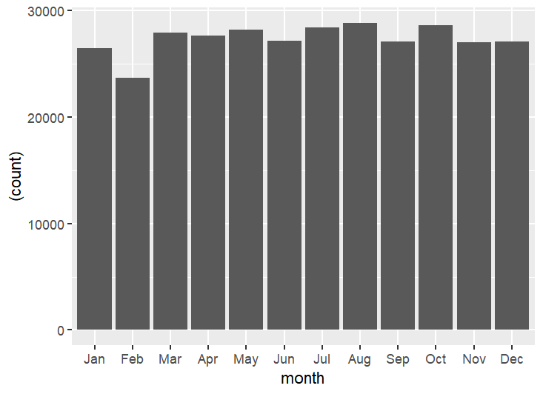
Extract components
Can we plot the number of flights by month, displaying month names?
Reminder, the data looks like this:
[1] "2013-07-18 12:03:00 UTC"
[2] "2013-10-26 07:22:00 UTC"
[3] "2013-10-02 19:24:00 UTC"
[4] "2013-10-13 14:01:00 UTC"
[5] "2013-12-08 09:47:00 UTC"
flights_dt %>%
mutate(month = month(flights_dt$dep_time, label = TRUE)) %>%
ggplot(aes(x = month)) + geom_bar(aes(y = (..count..)))

Slide 13
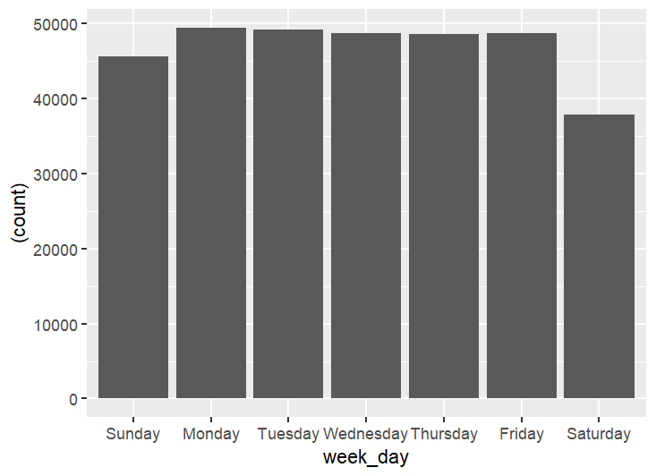
Extract components
Can we plot the number of flights by the day of the week, with names of the days without abbreviations?
Reminder, the data looks like this:
[1] "2013-07-18 12:03:00 UTC"
[2] "2013-10-26 07:22:00 UTC"
[3] "2013-10-02 19:24:00 UTC"
[4] "2013-10-13 14:01:00 UTC"
[5] "2013-12-08 09:47:00 UTC"
flights_dt %>%
mutate(week_day = wday(flights_dt$dep_time, label = TRUE, abbr = FALSE)) %>%
ggplot(aes(x = week_day)) + geom_bar(aes(y = (..count..)))

Slide 14
Set components in dates/times
example2 <- ymd_hms("2022-11-21 12:20:59")
Change the year
> year(example2) <- 2015
> example2
[1] "2015-11-21 12:20:59 UTC"
Change the hour
> hour(example2) <- 18
> example2
[1] "2022-11-21 18:20:59 UTC"
> hour(example2) <- hour(example2) + 06
> example2
[1] "2022-11-21 18:20:59 UTC"
Change the month
> month(example2) <- 02
> example2
[1] "2022-02-21 12:20:59 UTC"
Can we set multiple components at once?
> update(example2, minute = "00", second = "00")
[1] "2022-11-21 12:00:00 UTC"

Slide 15
Incorrectly set components
example3 <- ymd_hms("2022-02-21 12:20:59")
What happens if we set 30 days in February?
> day(example3) <- 30
> example3
[1] "2022-03-02 12:20:59 UTC"
Rolls over to March!
What happens if we add 12 hours to example3?
> hour(example3) <- hour(example3) + 12
> example3
[1] "2022-02-22 00:20:59 UTC"
Rolls over to the next day!

Slide 16
Time spans - durations, periods, intervals
Durations: measure the exact number of seconds that occur between two instants (track the passage of physical time, which deviates from clock time when irregularities occur - e.g. daylight savings)
Periods: measure the change in clock time by days, hours, etc. that occurs between two instants (ignore time irregularities - more human)
Intervals: represent a start and an end point.
paris_agr <- dmy("22.04.2016")
today <- today()
> how_old <- today - paris_agr
#Base R
> how_old
Time difference of 2398 days
> class(how_old)
[1] "difftime"
#Duration
> as.duration(how_old)
[1] "207187200s (~6.57 years)"
#Period
> as.period(how_old)
[1] "2398d 0H 0M 0S"
#Interval
> paris_agr %--% today
[1] 2016-04-22 UTC--2022-11-15 UTC

Slide 17
Durations v. Periods?
Duration - in seconds
> dseconds(1)
[1] "1s"
> dminutes(1)
[1] "60s (~1 minutes)"
> dhours(1)
[1] "3600s (~1 hours)"
> ddays(1)
[1] "86400s (~1 days)"
> dweeks(1)
[1] "604800s (~1 weeks)"
> dyears(1)
[1] "31557600s (~1 years)"
Periods - more readable for humans
> seconds(1)
[1] "1S"
> minutes(1)
[1] "1M 0S"
> hours(1)
[1] "1H 0M 0S"
> days(1)
[1] "1d 0H 0M 0S"
> weeks(1)
[1] "7d 0H 0M 0S"
> years(1)
[1] "1y 0m 0d 0H 0M 0S"

Slide 18
Time spans – adding time
Duration - in seconds
> 2 * dyears(1)
[1] "63115200s (~2 years)"
> dyears(1) + dweeks(1) + dhours(1)
[1] "32166000s (~1.02 years)“
Periods - more readable for humans
> 2 * years(1)
[1] "2y 0m 0d 0H 0M 0S"
> years(1) + weeks(1) + hours(1)
[1] "1y 0m 7d 1H 0M 0S"
Interval – start and end times
> now()
[1] "2022-11-16 16:33:54 CET"
> interval(now, now + days(1))
[1] "2022-11-16 16:33:54 CET--2022-11-17 16:33:54 CET "

Slide 19
Durations v. Periods?
What happens when we do this?
one_pm <- ymd_hms( "2022-03-26 13:00:00", tz = "CET")
one_pm + ddays(1)
Daylight savings!
Duration - in seconds
one_pm <- ymd_hms( "2022-03-26 13:00:00", tz = "CET")
> one_pm
[1] "2022-03-26 13:00:00 CET"
> one_pm + ddays(1)
[1] "2022-03-27 14:00:00 CEST"
Periods - more readable for humans
one_pm <- ymd_hms( "2022-03-26 13:00:00", tz = "CET")
> one_pm
[1] "2022-03-26 13:00:00 CET"
> one_pm + days(1)
[1] "2022-03-27 13:00:00 CEST"

Slide 20
Durations v. Periods?
What about this?
ymd("2020-01-01") + dyears(1)
Leap year!
Duration - in seconds
> ymd("2020-01-01") + dyears(1)
[1] "2020-12-31 06:00:00 UTC"
Periods - more readable for humans
> ymd("2020-01-01") + years(1)
[1] "2021-01-01"

Slide 21
Time zones
R uses the international standard IANA time zones which was a database originally compiled by Arthur David Olson and is now managed by IANA. It uses a consistent naming scheme of Continent/City (with a few exceptions).
Unless otherwise specified, lubridate always uses UTC (similar to GMT).
You can check the complete complete list of all time zone names with OlsonNames()
> length(OlsonNames())
[1] 594
> head(OlsonNames())
[1] "Africa/Abidjan" "Africa/Accra" "Africa/Addis_Ababa"
[4] "Africa/Algiers" "Africa/Asmara" "Africa/Asmera"

Slide 22
Time zones
Why do time zones matter?
> x1 <- ymd_hms("2015-06-01 12:00:00", tz = "America/New_York")
> x1
[1] "2015-06-01 12:00:00 EDT"
> x2 <- ymd_hms("2015-06-01 18:00:00", tz = "Europe/Copenhagen")
> x2
[1] "2015-06-01 18:00:00 CEST"
> x3 <- ymd_hms("2015-06-02 04:00:00", tz = "Pacific/Auckland")
> x3
[1] "2015-06-02 04:00:00 NZST"
Is there a difference between these times?
No!
> x1 - x2
Time difference of 0 secs
> x2 - x3
Time difference of 0 secs
> x1 - x3
Time difference of 0 secs

Slide 23
Comparing time zones
Current date and time: "2022-11-15 19:16:47 CET"
Get the same clock time in a new time zone - in Australia
> force_tz(now, tzone = "Australia/Lord_Howe")
[1] "2022-11-15 19:16:47 +11"
Get the same moment (date and time) as per Australia’s date and time
> with_tz(now, tzone = "Australia/Lord_Howe")
[1] "2022-11-16 05:16:47 +11"

Slide 24
Let’s try using what we learnt in an exercise!

Slide 25
References
Grolemund, G. and Wickham, H. (2011) ‘Dates and times made easy with lubridate’, Journal of Statistical Software, 40(3), pp. 1–25. doi: 10.18637/jss.v040.i03.
Lubridate Cheatsheet. (n.d.) https://lubridate.tidyverse.org/.
RichardonData. (2020) ‘Handling Datetimes in R with "lubridate" | R Tutorial (2020)’. https://www.youtube.com/watch?v=VYAo69WdJZg.
Wickham, H. and Grolemund, G. (2017) R for Data Science, Journal of Statistical Software. O’Reilly Media, Inc. doi: 10.18637/jss.v077.b01.

